Slide 1

Basics Of Java Program

Slide 2

Exam Objectives
Create an executable Java program with a main class
Compile and run a Java program from the command line

Slide 3
Steps to run a Java program
Step 1 : Writing the code for executing a functionality.
Step 2 : Save the code in (Step 1) into a file with .java extension.
Steps 3 : Compile the .java file using the javac command. This will generate a .class file.
Step 4 : Run the program using the java command and the generated .class file.
a b c
a b c

Slide 4
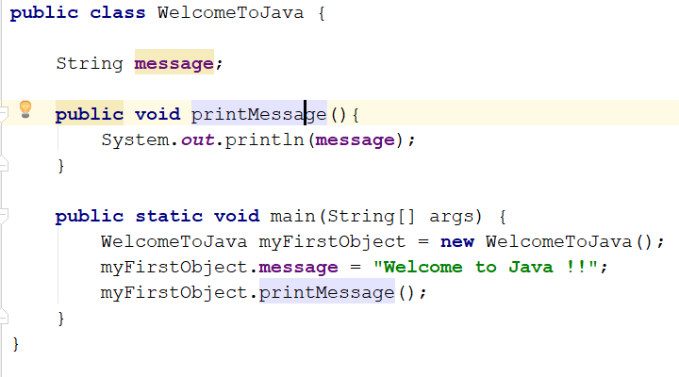
Writing the first Java program
WelcomeToJava is the name of a class. This class is present in a file named WelcomeToJava.java
The class WelcomeToJava contains a method named main().
The method main() takes in a parameter of type String.
The statement System.out.println is used to print to the command line. Here the program prints the string ‘Welcome to Java !!’ on the command line.
a b c

Slide 5

Entry Point to the World of Java : main() method
Serves as an entry point to any java program. Almost all java programs whether it be a web server written in java or a web application or a desktop application , all begin with a main method and then extend further.
Just like a VISA document acts like an entry point to any country and you need to satisfy all the conditions in order to possess one, similar is the case with main method in java.
There many valid and invalid ways of writing a main method.

Slide 6
Command Line Arguments
While running a java program we can pass on some input to the program.
Java reads this input in a String array.
Ways of passing command lines :
a b c
a b c
“a ” b c
In case if no argument is passed, an array of zero size is passed.
Example : The programmer may want to write a program to print a message of his choice on the command line. The programmer would just pass the message that he wants to be displayed on command line and the program would display it.
a b c
a b c

Slide 7
Compile Step
As per wiki , a compiler is a computer program that translates computer code written in one programming language (the source language) into another language (the target language
Java compiler takes the source code written in a .java file and converts that code into an intermediate code known as Bytecode.
The intermediate byte code that is generated during the compile step is an important step as that makes Java platform independent. This means that the .class file can be taken on any platform/machine/OS and executed there.
a b c
a b c

Slide 8
C++: The pre-Java world
Java is primarily based one of the popular programming language.
One of the major drawback of C++ was that the executable code was not platform independent. This means that the code written in C++ had to be compiled again and again for different platforms. This was a teadious task for a programmer to do.
Java creators had this issue at the back of their mind and they wrote java in such a was to do away with this drawback.
a b c
a b c

Slide 9
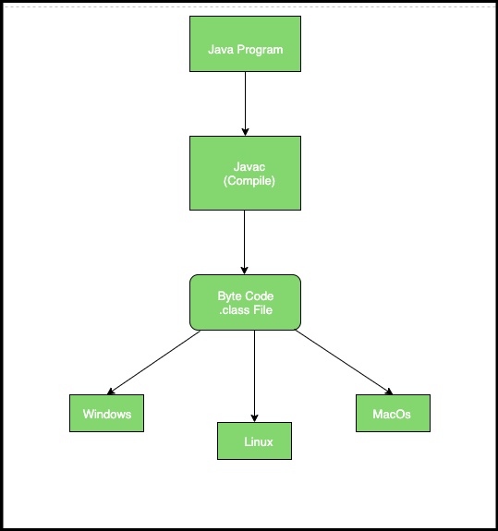
Java:Platform Independency
This is known as Write once run anywhere (WORA).
a b c
a b c

Slide 10
Java Virtual Machine
Java virtual machine (JVM) is the piece of software that is responsible for running a java application.
A java application is executed by the following command : java WelcomeToJava
Here ‘java’ represents the java virtual machine(JVM) which runs the java program.
a b c
a b c

Slide 11

Questions ??
a b c

